Slide 1

Team Name – Aniruddha
Problem Statement ID – ICIH-3
Problem Statement Title – Enhance safety and accessibility in public and residential spaces focusing on inclusivity.
Theme – Smart Living ,Urban Innovation & Industrialization
1

Slide 2
Idea Title
AI-Powered Community Safety & Real-Time Alert System
An Android-based app integrated with AI-driven camera threat detection.
Works with existing CCTV networks in societies, industries, and public spaces.
Sends instant, location-based alerts to nearby verified users and local authorities.
Builds dynamic community groups to enable fastest responders in an emergency.
2

Slide 3
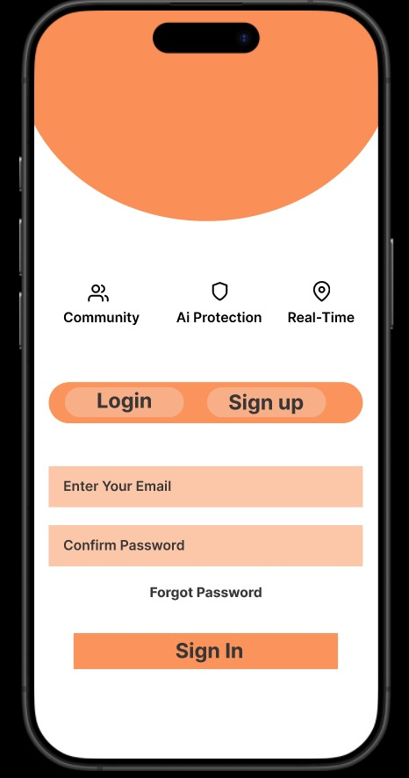
Proposed Solution
Problem Being Addressed:
  Slow response time during emergencies.
  Lack of citizen engagement in safety.
  Inefficient use of existing CCTV systems.
Solution Highlights:
  AI model analyzes live video feeds for accidents, suspicious activities, theft, kidnappings, fire, or road mishaps.
  Alert system pushes verified notifications to:
    Nearby community users
    Local police station/authorities
  Community-based validation (upvote/downvote) ensures false alarms are minimized.
Innovation(Novality):
  First system to combine AI safety detection + Geo-based citizen response.
  Preventive model — not just reactive like traditional surveillance.
3

Slide 4
Technical Approach (Technology Stack)
Frontend (Mobile App):
  React native / Jetpack Compose.
  Responsive UI for safety-critical alerts.
Backend & Database:
  Firebase Authentication (OTP-based).
  Firestore for real-time community feeds.
  Firebase Cloud Messaging for instant push notifications.
AI/ML Layer:
  Computer Vision: YOLOv8 / TensorFlow .
  Pre-trained datasets for crime, fire, accidents, intrusion.
  Continuous learning with community feedback.
Security:
  End-to-End Encryption for alerts.
  Secure OTP-based user verification.
4

Slide 5
Technical Approach (Workflow & Architecture)
Step 1: CCTV → AI Threat Analysis (Server/Edge device)
Step 2: If threat detected → Alert Engine triggers
Step 3: Alerts sent to →
    App users nearby
    Local authorities
Step 4: Community responds → validates alerts
Step 5: System auto-filters false alarms & strengthens model
5

Slide 6
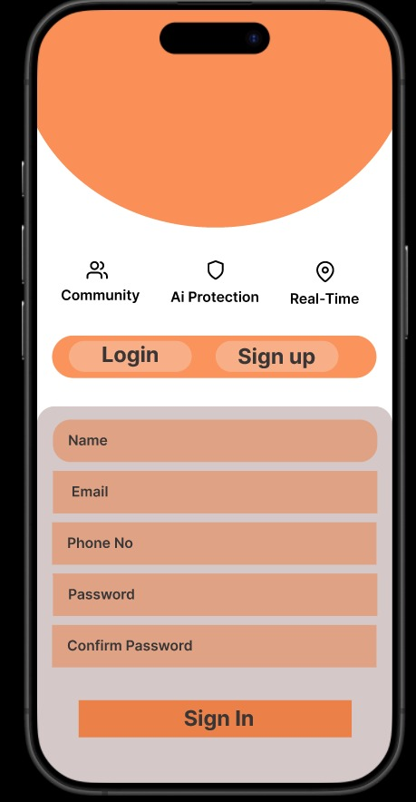
Feasibility & Viability
Feasibility:
  Works with existing infrastructure (CCTV cameras) → no costly hardware upgrade.
  Scalable cloud-based backend (Firebase).
  AI model tested on real-world surveillance datasets.
Backend & Database:
  False Positives/Negatives – incorrect detection of incidents.
  User Privacy Concerns – live video data handling.
  Adoption – encouraging communities to trust and engage.
AI/ML Layer:
  Continuous model training with feedback loops.
  Data anonymization (no personal identification stored).
  Gamification & reward points for active community responders.
6

Slide 7
Impact & Benefits
Social Impact:
  Empowers citizens to become first responders.
  Safer societies, offices, and transport hubs.
  Builds trust between community & law enforcemen.
Economic Benefits:
  Reduces damage/loss from crimes & accidents.
  Low-cost solution using existing surveillance infrastructure.
Environmental Benefits:
  No need for new hardware – eco-friendly digital solution.
Overall Impact:
  Faster intervention = lives saved.
  Stronger community = safer cities.

Slide 8
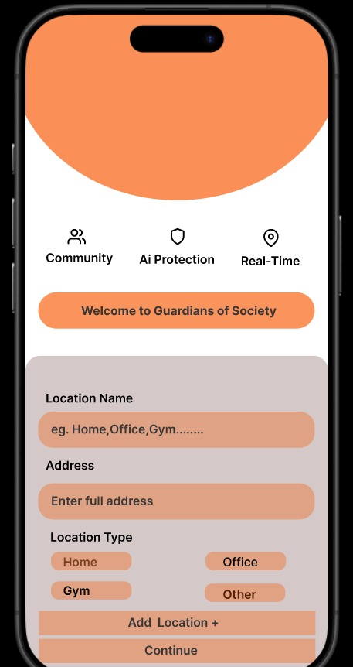
Key Features of the App
User Onboarding: Secure login with phone/email OTP.
Community Groups: Auto-created based on user’s daily routine & mapped locations (Home, Office, Gym).
Incident Dashboard: Real-time incident feed filtered by proximity.
Voting System: Upvote (real) / Downvote (fake) to improve AI detection.
User Profile Section: Emergency contacts, routines, preferences.
Smart Suggestions: App suggests joining nearby communities for safety.
8

Slide 9
Research & References
Research Base:
  Studies on Community Policing & Citizen Response Systems.
  Papers on AI for Crime Detection using CCTV.
  Smart City surveillance case studies (Singapore, Dubai).
Technical References:
  YOLOv8 for real-time object & activity recognition.
  Firebase documentation for scalable backend.
  MIT & IEEE papers on AI-driven urban safety.
Competitive Analysis:
  Similar apps exist for crime reporting but lack community validation & AI-based auto-detection.
9

Slide 10
Thankyou
10

